Slide 1
CSS3: Lesson

Slide 2
Agenda
Presentation versus content
CSS basics
The link between HTML and CSS
CSS selector and declaration
CSS Specificity
Inline flow and block flow
Pseudo-classes
Pseudo-elements
CSS Box model

Slide 3
What is CSS?
CSS (Cascading Style Sheets) is a sequence of rules.
CSS3 is the latest version, corresponds to HTML5
CSS3 is that it’s backward compatible with previous versions of CSS
Notes:
Tip: Add your own speaker notes here.

Slide 4
Presentation vs. Content
Content is the words and images in an HTML document.
Presentation is related to styles and how words and images "look" in an HTML document.
Content is managed as HTML and style as CSS.
The separation of HTML and CSS generally means keeping CSS styles in a file separate from the HTML file.
Notes:
Tip: Add your own speaker notes here.

Slide 5

How to add CSS to HTML?
1. Inline CSS:
<h1 style="color:blue; margin:40px;">Some header</h1>
2. Internal Style Sheet:
<head>
<style> h1 { color: blue; margin: 40px; } </style>
</head>
3. External file:
<head>
<link href="default.css" rel="stylesheet">
</head>

Slide 6
The Link Between HTML and CSS
The <link> element in an HTML file links the HTML file to a CSS file.
You can reference more than one CSS file in an HTML page.
Markup example:
For simple projects, can use the <style> tag to include styles within an HTML document
<link href="style.css"
rel="stylesheet" type="text/css">
Notes:
Tip: Add your own speaker notes here.

Slide 7
CSS Selector and Declaration
The selector is usually the HTML element you want to style.
The declaration is the style for a specific selector.
A declaration has a property, which is a style attribute, and a value.
Selector
Declaration
p
{ color: red; }
Property
Value
Notes:
Tip: Add your own speaker notes here.

Slide 8
CSS Selectors
Let’s answer the question “What can be a selector?”
element – concrete tags.
.class – elements which have value of class attribute set "class"
#id – element which have value of id attribute set "id"
* – all elements from page

Slide 9
CSS Selectors - General
Selector | Example | Description
elem1, elem2 | div, p | Selects all <div> elements and all <p> elements
elem1 elem2 | div p | Selects all <p> elements inside <div> elements
elem1>elem2 | div>p | Selects all <p> elements where the parent is a <div> element
elem1+elem2 | div+p | Selects all <p> elements that are placed immediately after a sibling <div> elements
elem1~elem2 | div~p | Selects every <p> element that are preceded by a <div> element
[attr] | [src] | Selects all elements with a src attribute

Slide 10
CSS Selectors - General
Selector | Example | Description
[attr=value] | [alt=picture] | Selects all elements with alt=picture
[attr~=value] | [alt~=flower] | Selects all elements with a alt attribute containing the word flower
[attr^=value] | a[href^="https"] | Selects every <a> element whose href attribute value begins with "https"
[attr$=value] | a[href$=".pdf"] | Selects every <a> element whose href attribute value ends with ".pdf"
[attr*=value] | a[href*="w3schools"] | Selects every <a> element whose href attribute value contains the substring "w3schools"

Slide 11
CSS Specificity
Specificity is the means by which a browser decides which CSS property values are the most relevant to an element and therefore will be applied.
The specificity is a weight that is applied to a given CSS declaration based on the count of each selector type.
Details: https://css-tricks.com/specifics-on-css-specificity/

Slide 12
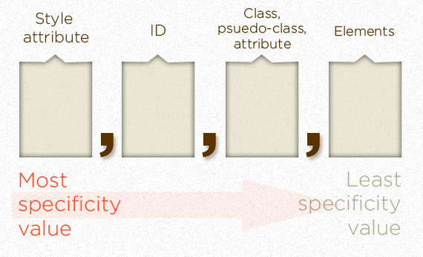
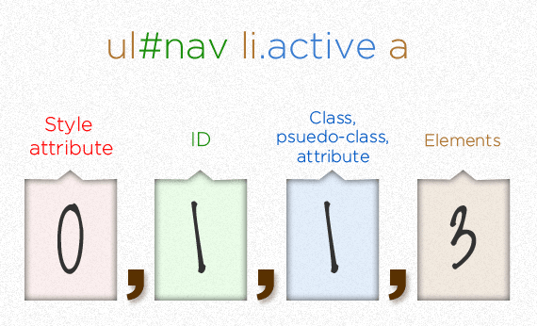
Calculating CSS Specificity Value

Slide 13
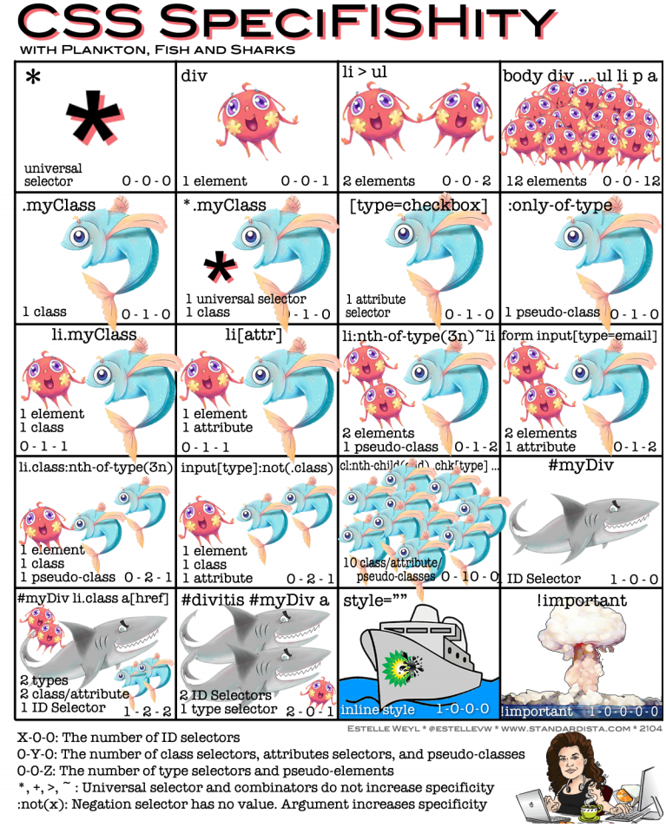

Slide 14
The !important exception
When an !important rule is used on a style declaration, this declaration overrides any other declaration made in the CSS, wherever it is in the declaration list.
Although, !important has nothing to do with specificity.
Using !important is bad practice and should be avoided because it makes debugging more difficult by breaking the natural cascading in your stylesheets.

Slide 15
Browser Default Styles
Web browsers have default CSS styles for HTML elements.
Also these styles are different for different browsers, so same markup may look different.
To ensure same markup looks the same it is recommended to use "reset" or "normalize" stylesheets (second is preferred):
Reset CSS: http://meyerweb.com/eric/tools/css/reset/
Normalize CSS: http://necolas.github.io/normalize.css/
Notes:
Differences between Reset and Normalize
http://nicolasgallagher.com/about-normalize-css/
https://htmlacademy.ru/blog/64

Slide 16
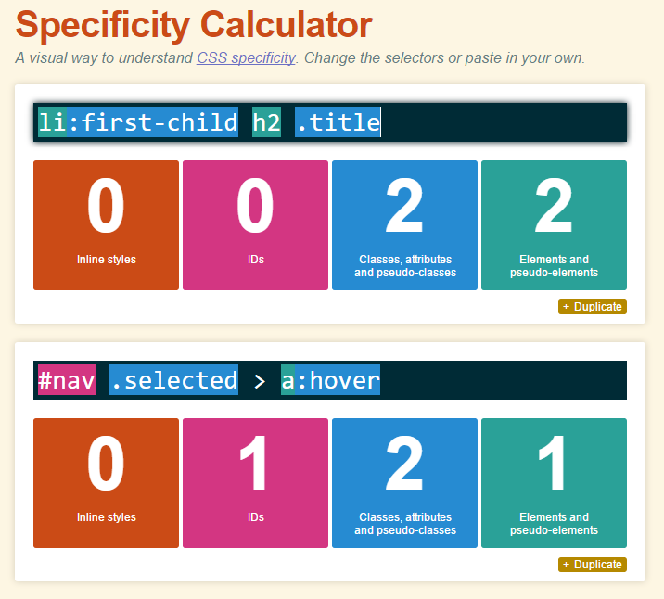
CSS Specificity Calculator
http://specificity.keegan.st/

Slide 17
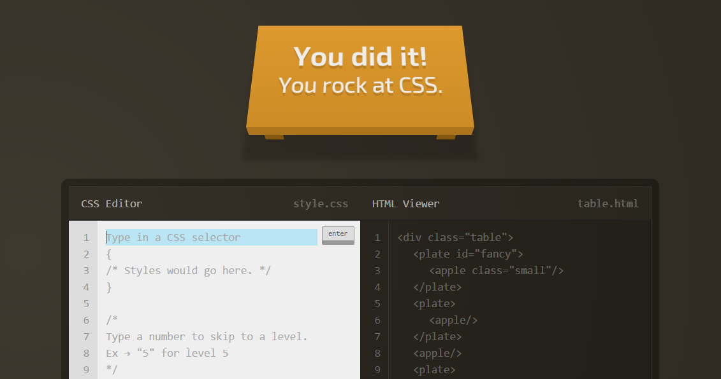
Practice Task: Pass CSS Game
http://flukeout.github.io/

Slide 18
Inline Flow and Block Flow
Inline flow fills only as much width as required.
Block flow fills as much width as is available.
inline
inline
inline
inline
inline
inline
inline
inline
inline
block
block
block
Notes:
Tip: Add your own speaker notes here.

Slide 19
The display property
The display property specifies the display behavior (the type of rendering box) of an element.
The main values of the display property is:
inline : displays an element as an inline element (like <span>). Any height and width properties will have no effect
block : displays an element as a block element (like <p>). It starts on a new line, and takes up the whole width
inline-block : displays an element as an inline-level block container. The element itself is formatted as an inline element, but you can apply height and width values
list-item : let the element behave like a <li> element
table : let the element behave like a <table> element
none : the element is completely removed

Slide 20
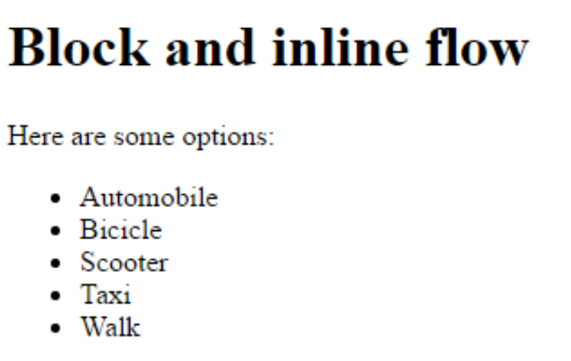
Block Flow Example
<!doctype html> <html> <head> <title>Block and Inline Flow</title> </head> <body> <h1>Block and inline flow</h1> <p>Here are som options:</p> <ul class="toolbar"> <li>Automobile</li> <li>Bicicle</li> <li>Scooter</li> <li>Taxi</li> <li>Walk</li> </ul> </body> </html>
https://codepen.io/mdem/pen/RYPXpV
Notes:
Tip: Add your own speaker notes here.

Slide 21
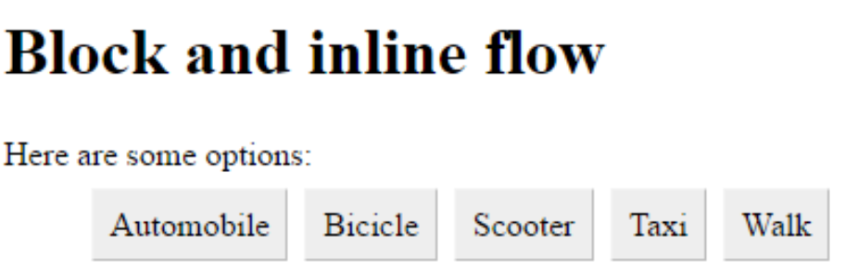
Inline Flow Example
<head> <title>Block and Inline Flow</title> <style> .toolbar li { display: inline; background-color: #EEE; border: 1px solid; border-color: #F3F3F3 #BBB #BBB #F3F3F3; margin: 2px; padding: 8px; } </style> </head> <body> <h1>Block and inline flow</h1> <p>Here are some options:</p> <ul class="toolbar"> <li>Automobile</li> <li>Bicicle</li> <li>Scooter</li> <li>Taxi</li> <li>Walk</li> </ul> </body>
https://codepen.io/mdem/pen/XPbvRv

Slide 22
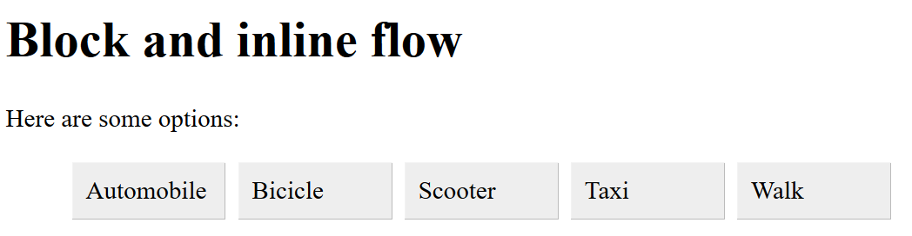
Inline-block Flow Example
Inline-block elements are like inline elements but they can have a width and a height.
<style> .toolbar li { display: inline-block; width: 80px; background-color: #EEE; border: 1px solid; border-color: #F3F3F3 #BBB #BBB #F3F3F3; margin: 2px; padding: 8px; } </style>
https://codepen.io/mdem/pen/mGJNLq

Slide 23
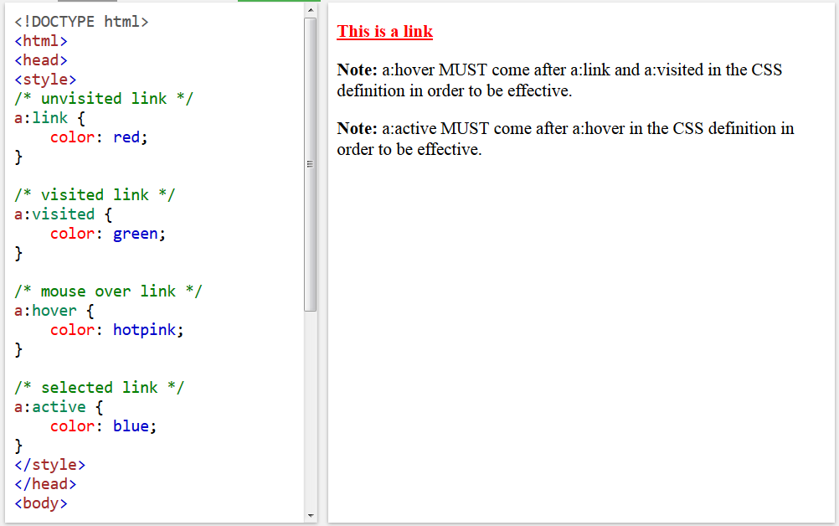
CSS Pseudo-classes
A CSS pseudo-class is a keyword added to selectors that specifies a special state of the element to be selected.
For example :hover will apply a style when the user hovers over the element specified by the selector.
https://www.w3schools.com/css/css_pseudo_classes.asp

Slide 24
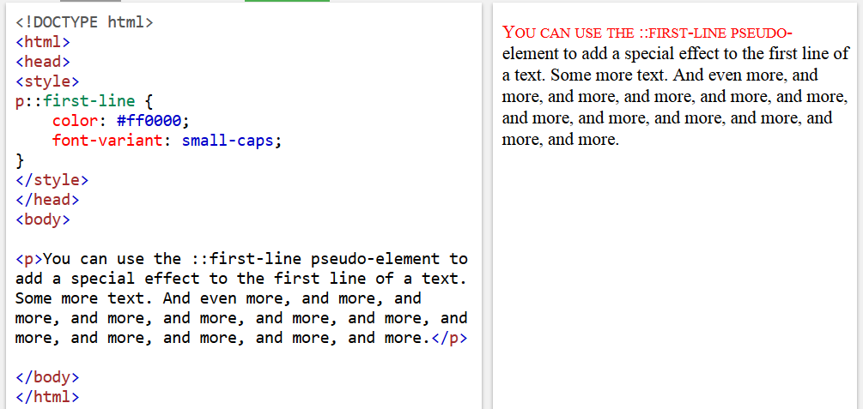
CSS Pseudo-elements
Like pseudo-classes, pseudo-elements are added to selectors but instead of describing a special state, they allow you to style parts of a document.
For example, the ::first-line pseudo-element targets only the first line of an element specified by the selector.
https://www.w3schools.com/css/css_pseudo_elements.asp

Slide 25
Pseudo-classes and Pseudo-elements
Selector | Example | Example description
:hover | a:hover | Selects links on mouse over
::after | p::after | Insert something after the content of each <p> element
::before | p::before | Insert something before the content of each <p> element
:checked | input:checked | Selects every checked <input> element
:disabled | input:disabled | Selects every disabled <input> element
:empty | p:empty | Selects every <p> element that has no children (including text nodes)
:enabled | input:enabled | Selects every enabled <input> element
:first-child | p:first-child | Selects every <p> element that is the first child of its parent
::first-letter | p::first-letter | Selects the first letter of every <p> element
::first-line | p::first-line | Selects the first line of every <p> element
:focus | input:focus | Selects the input element which has focus
:nth-child | p:nth-child(odd/even) | Selects child elements whose index is odd or even (the index of the first child is 1)

Slide 26
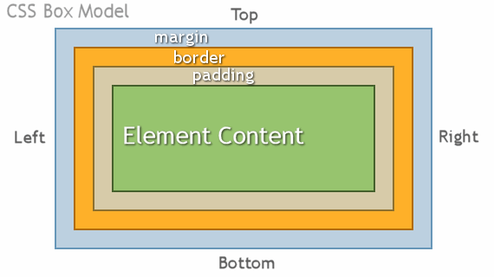
CSS Box model

Slide 27
Two CSS box models
In the W3C box model, the width of an element gives the width of the content of the box, excluding padding and border.
In the traditional box model, the width of an element gives the width between the borders of the box, including padding and border.
By default, all browsers use the W3C box model, with the exception of IE in "Quirks Mode" (IE5.5 Mode), which uses the traditional one.

Slide 28
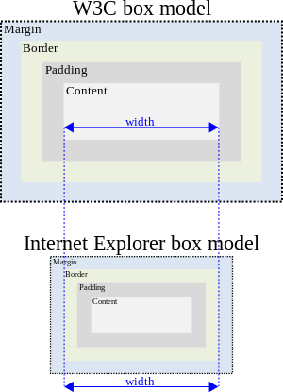
Two CSS box models
box-sizing: content-box
border-box
Notes:
Tip: Add your own speaker notes here.

Slide 29
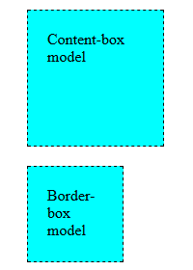
Box model sample
<body> <style type="text/css"> div { background: aqua; width: 100px; height: 100px; border: 1px dashed black; padding: 20px; margin: 20px; } #use-content-box { box-sizing: content-box; } #use-border-box { box-sizing: border-box; } </style> <div id="use-content-box"> Content-box model </div> <div id="use-border-box"> Border-box model </div> </body>

Slide 30
Contacts
Europe Headquarters
52 V. Velykoho Str.
Lviv 79053, Ukraine
Tel: +380-32-240-9090 Fax: +380-32-240-9080
E-mail: info@softserveinc.com
Website: www.softserveinc.com
US Headquarters
12800 University Drive, Suite 250 Fort Myers, FL 33907, USA
Tel: 239-690-3111 Fax: 239-690-3116
Thank You!

